Slide 1
Data Science Unit 2
Sampling Distributions Chapter 5

Slide 2
Learning Objectives
1. Describe the Properties of Estimators
2. Explain Sampling Distribution
3. Describe the Relationship between Populations & Sampling Distributions
4. State the Central Limit Theorem
5. Solve Probability Problems Involving Sampling Distributions
Notes:
As a result of this class, you should be able to ...

Slide 3
Inferential Statistics
Notes:
9

Slide 4
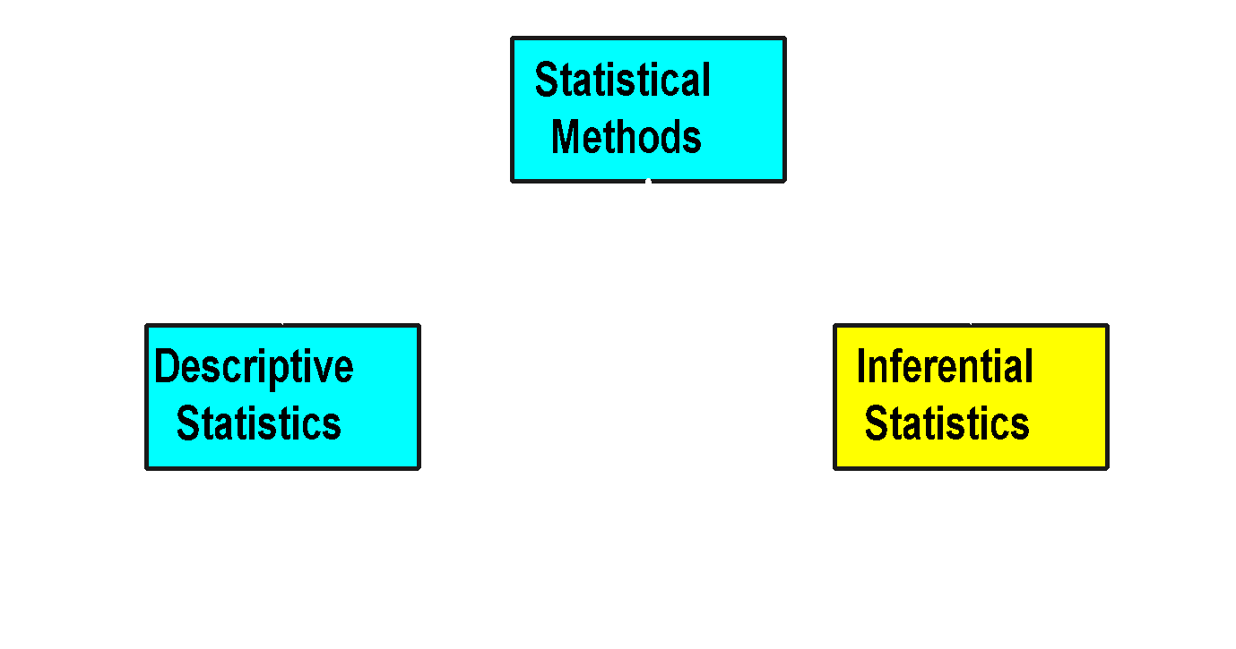
Statistical Methods

Slide 5


Inferential Statistics
1. Involves:
Estimation
Hypothesis Testing
2. Purpose
Make Decisions about Population Characteristics
Population?

Slide 6
Inference Process

Slide 7

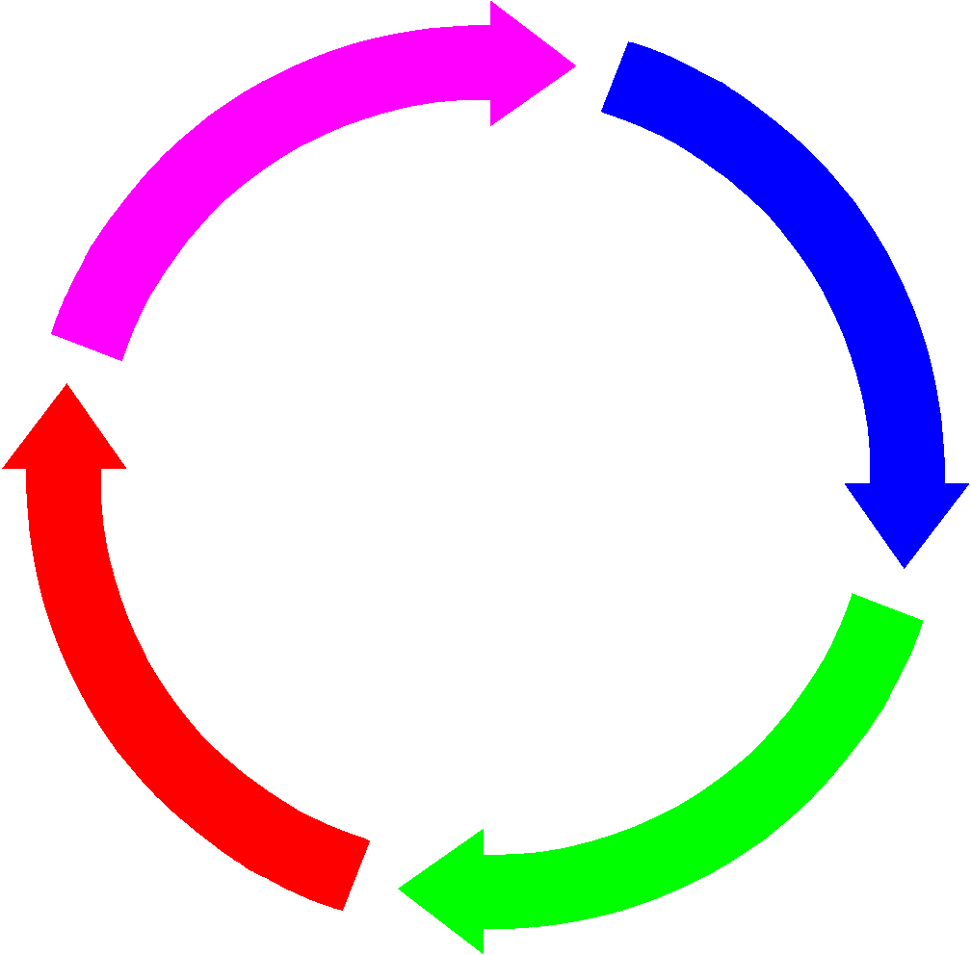
Inference Process
Population

Slide 8

Inference Process
Population
Sample

Slide 9

Inference Process
Population
Sample statistic (X)
Sample

Slide 10

Inference Process
Estimates & tests
Population
Sample statistic (X)
Sample

Slide 11
Estimators
1. Random Variables Used to Estimate a Population Parameter
Sample Mean, Sample Proportion, Sample Median
2. Example: Sample MeanX Is an Estimator of Population Mean μ
IfX = 3 then 3 Is the Estimate of μ
3. Theoretical Basis Is Sampling Distribution

Slide 12
Sampling from Normal Populations
Notes:
9

Slide 13
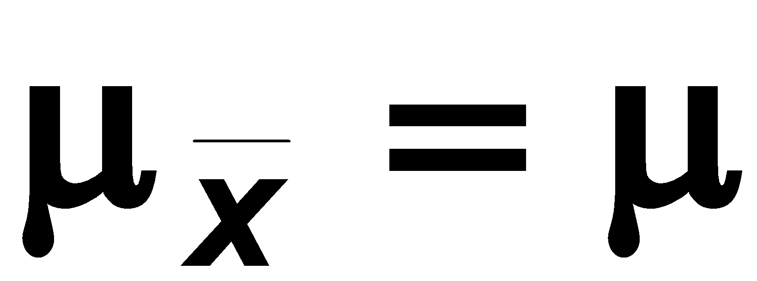
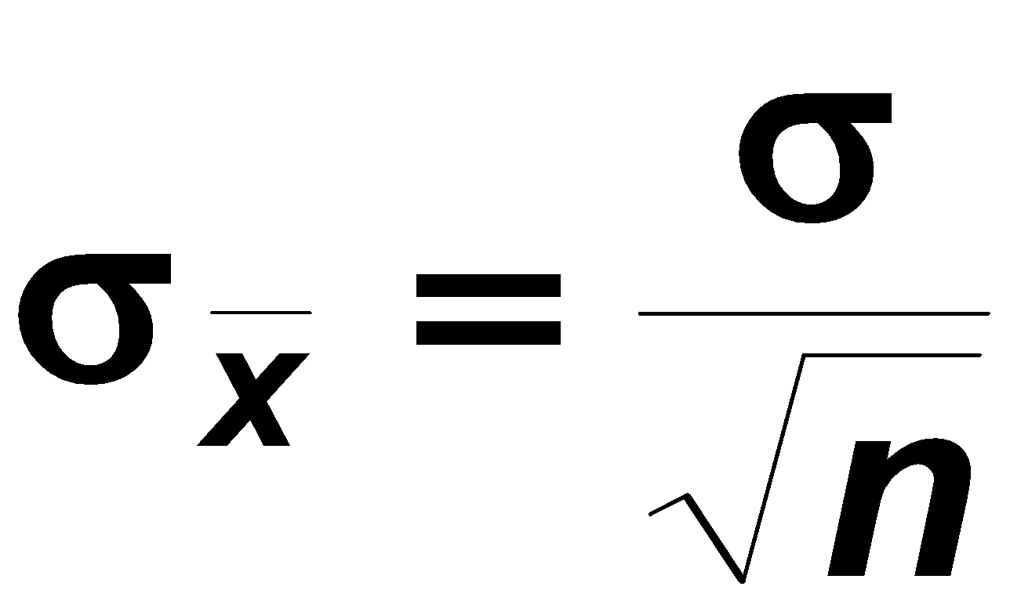
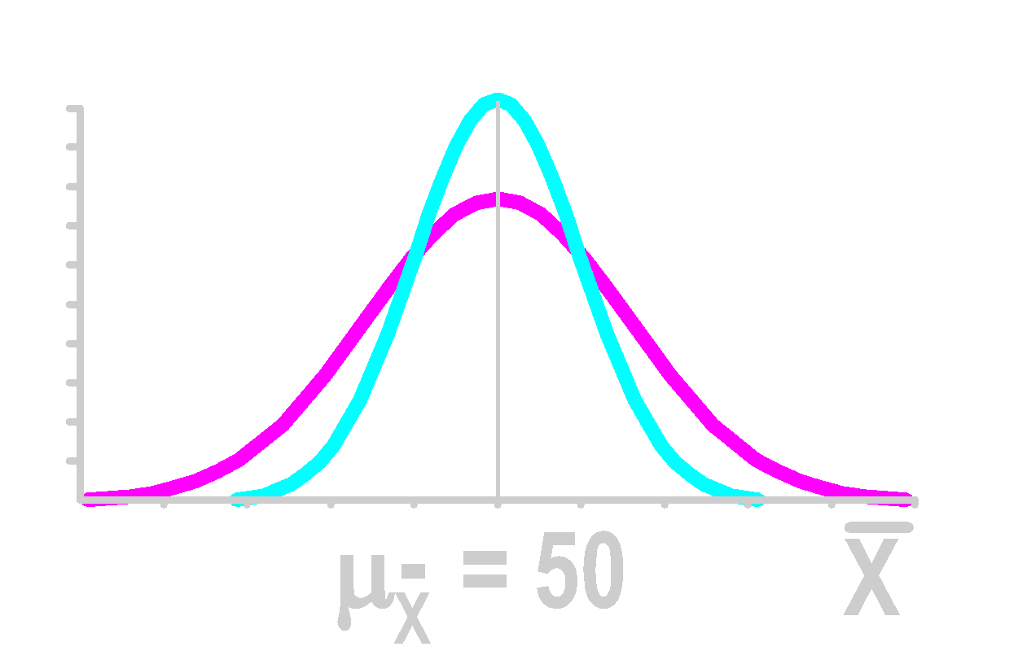
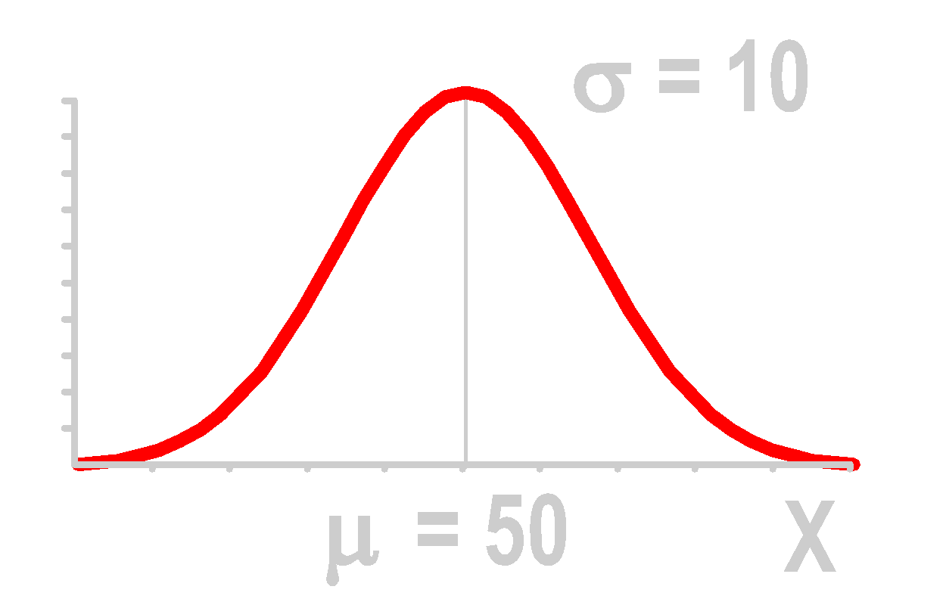
Sampling from Normal Populations
Central Tendency
Dispersion
Sampling with replacement
Population Distribution
Sampling Distribution
n = 4 σ_{X} = 5
n =16 σ_{X} = 2.5

Slide 14
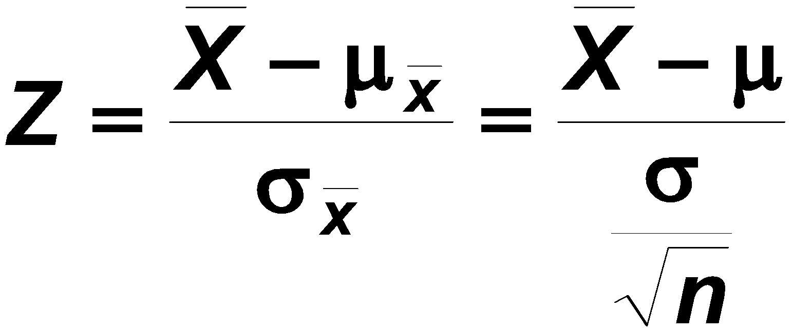
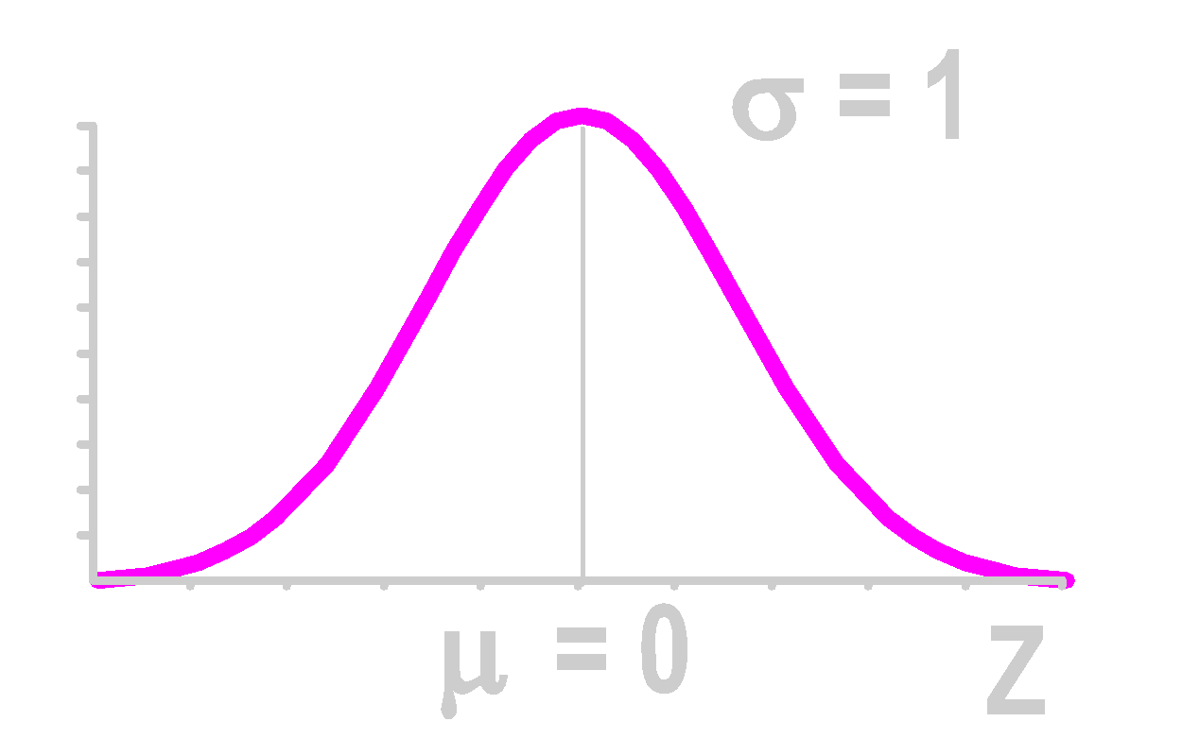
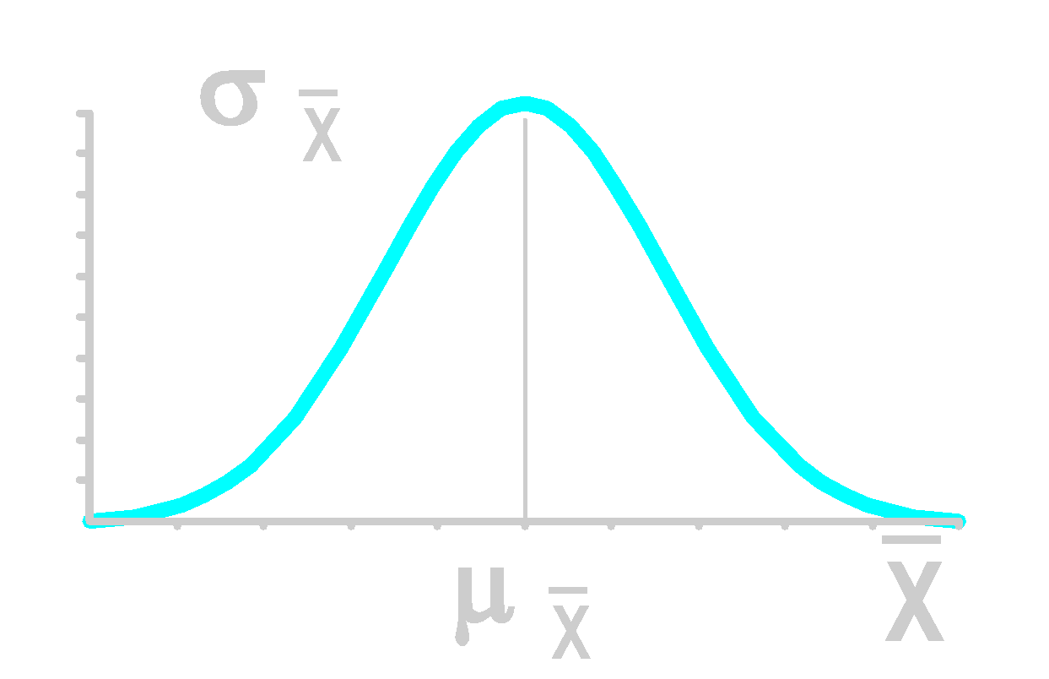
Standardizing Sampling Distribution of Mean
Sampling Distribution
Standardized Normal Distribution

Slide 15
Thinking Challenge
You’re an operations analyst for AT&T. Long-distance telephone calls are normally distribution with μ = 8 min. & σ = 2 min. If you select random samples of 25 calls, what percentage of the sample means would be between 7.8 & 8.2 minutes?
© 1984-1994 T/Maker Co.

Slide 16
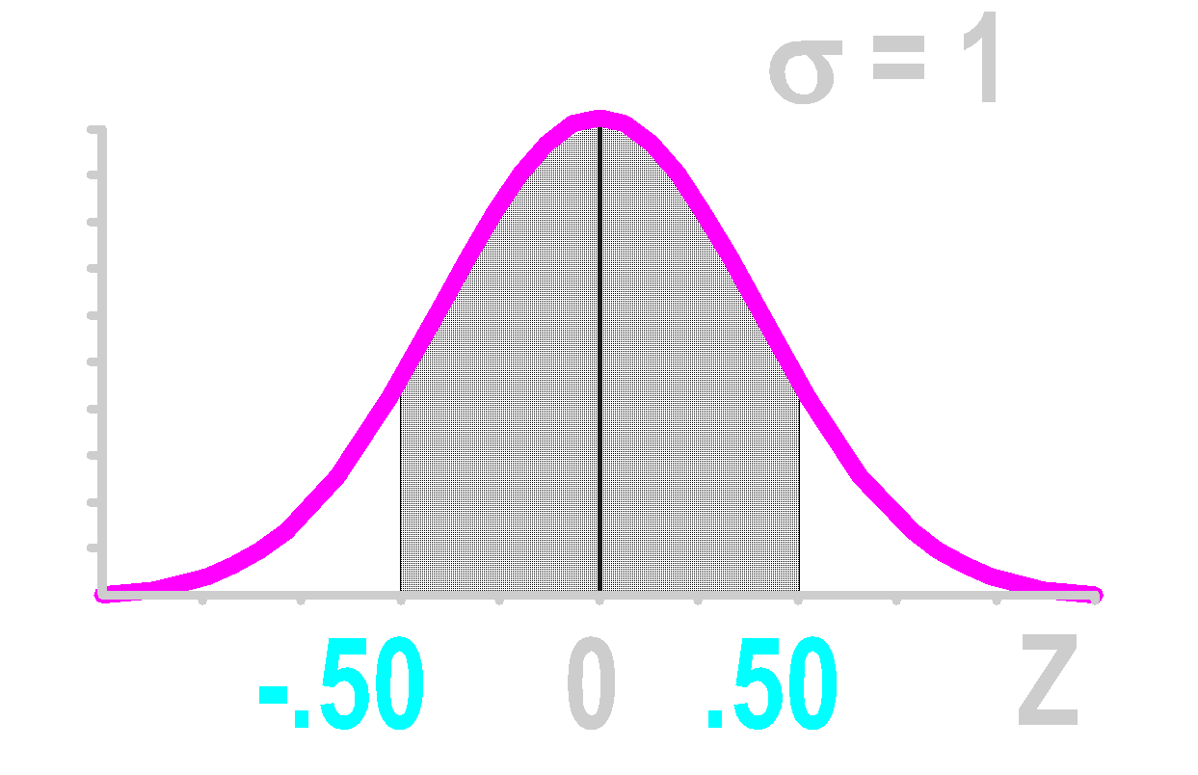
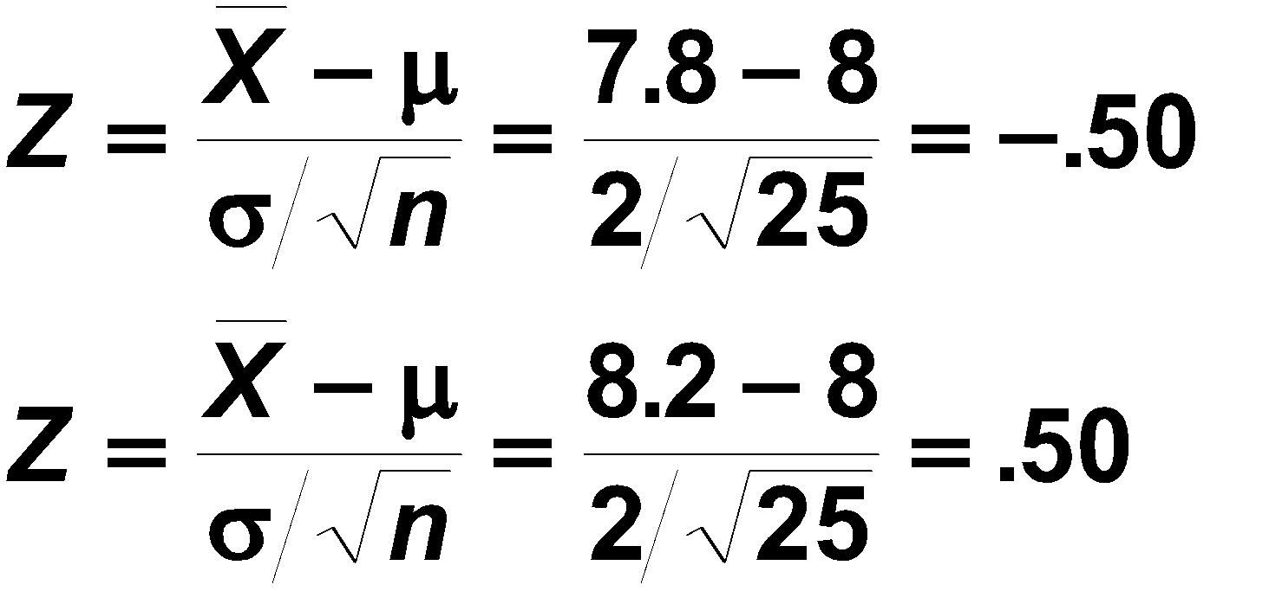
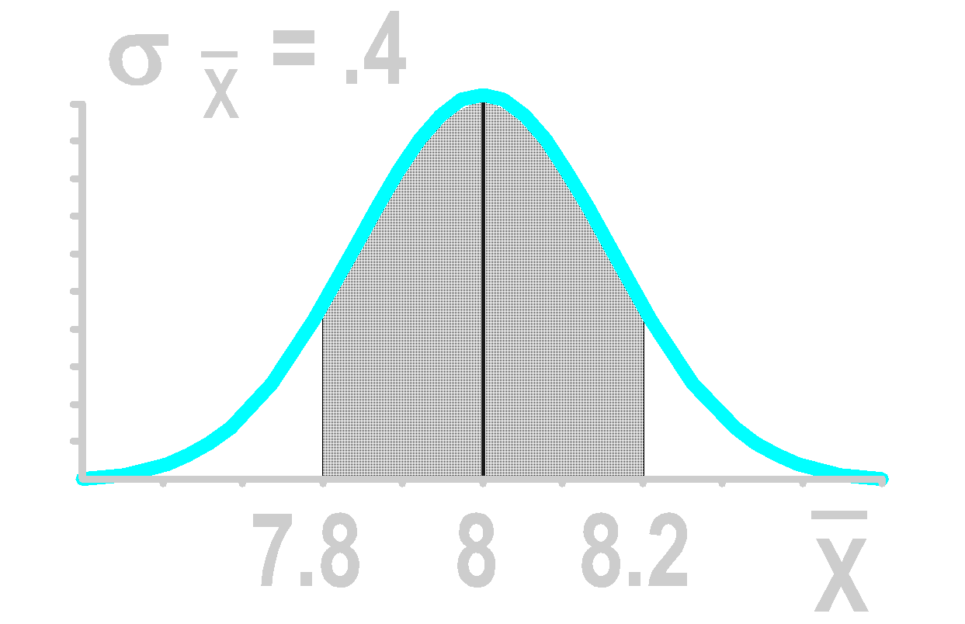
Sampling Distribution Solution*
Sampling Distribution
Standardized Normal Distribution
.3830
.1915
.1915

Slide 17
Sampling from Non-Normal Populations
Notes:
9

Slide 18
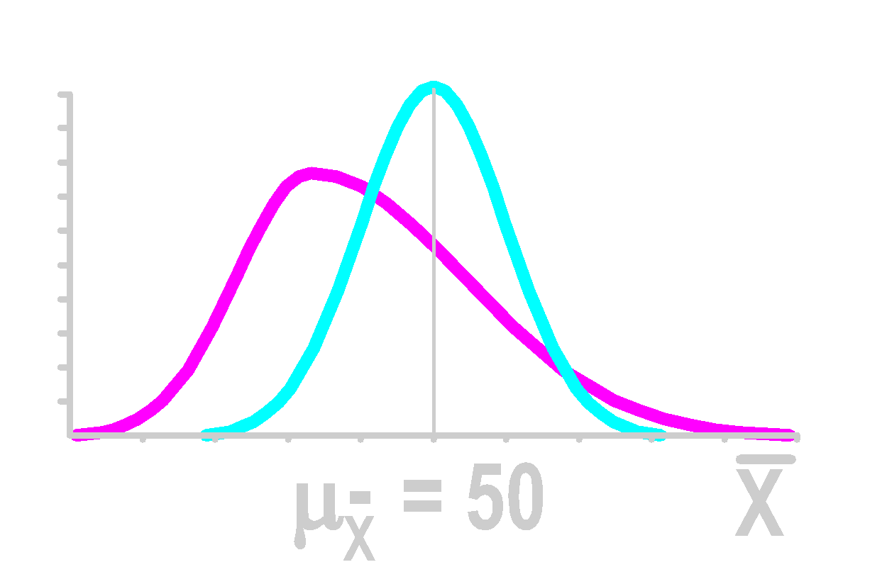
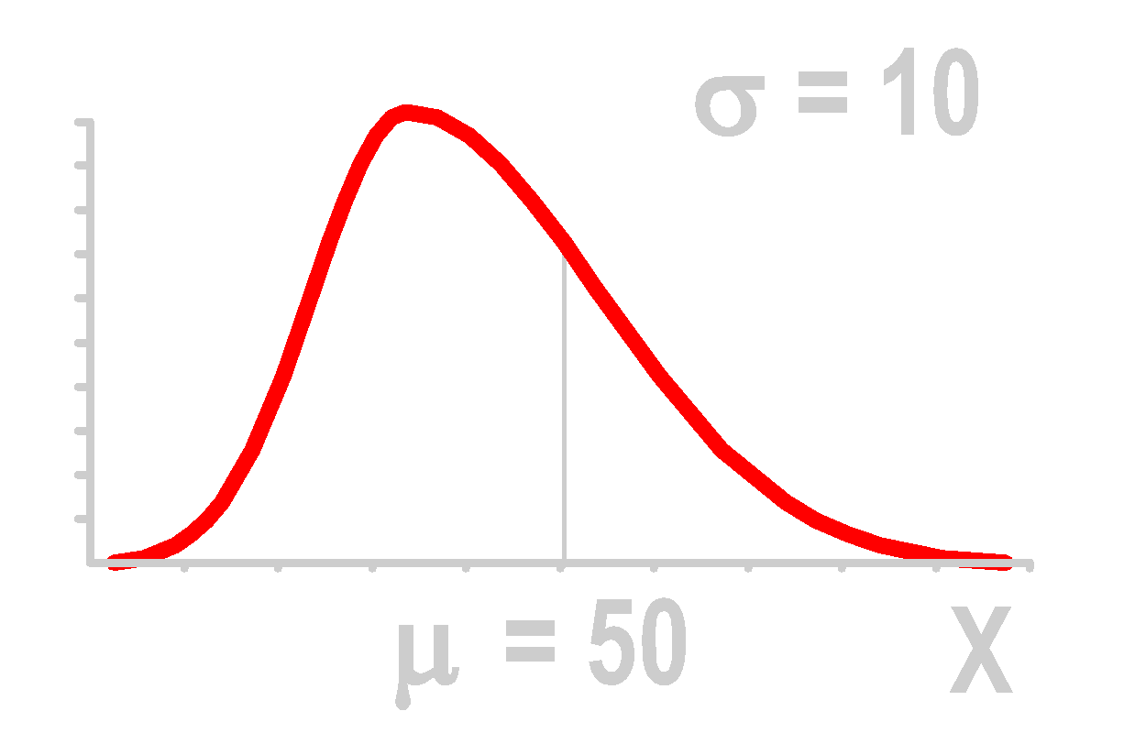
Sampling from Non-Normal Populations
Central Tendency
Dispersion
Sampling with replacement
Population Distribution
Sampling Distribution
n = 4 σ_{X} = 5
n =30 σ_{X} = 1.8

Slide 19
Central Limit Theorem
Notes:
9

Slide 20
Central Limit Theorem

Slide 21
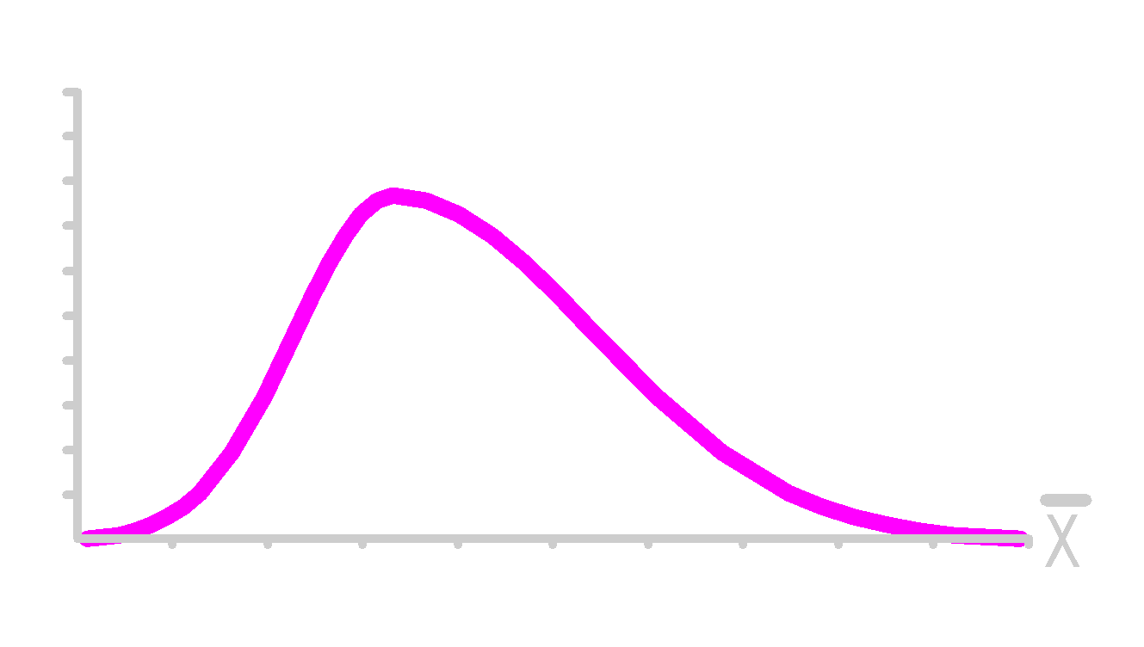
Central Limit Theorem
As sample size gets large enough (n ≥ 30) ...

Slide 22
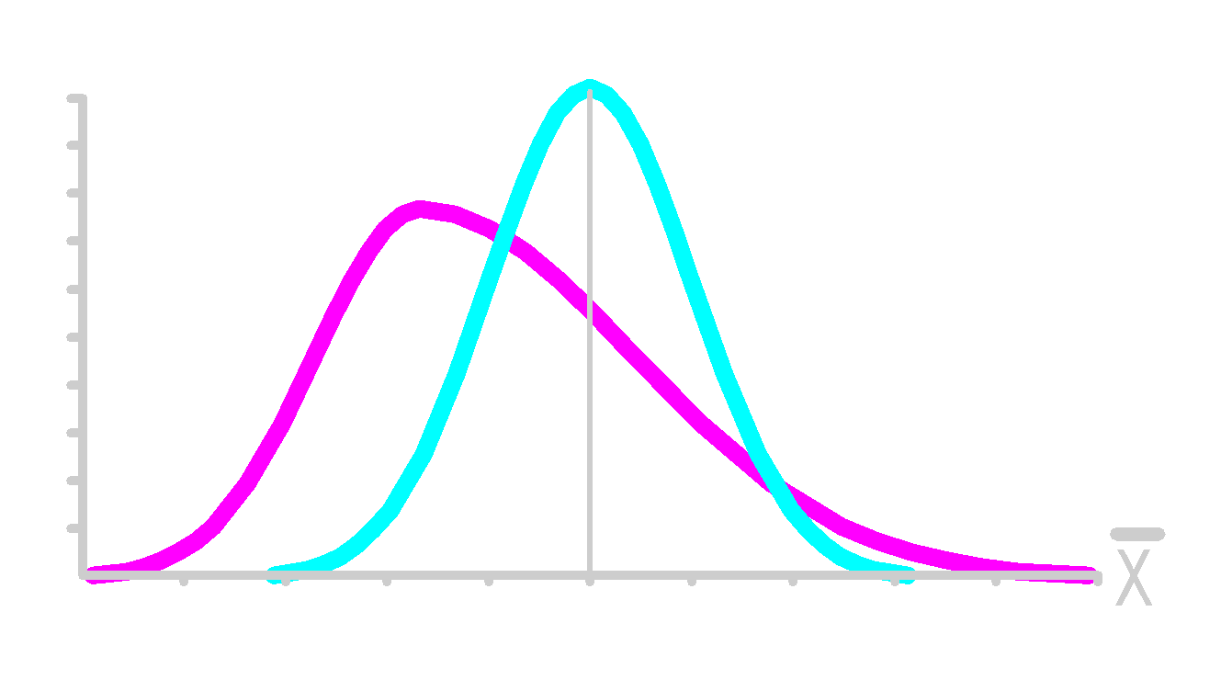
Central Limit Theorem
As sample size gets large enough (n ≥ 30) ...
sampling distribution becomes almost normal.

Slide 23
Central Limit Theorem
As sample size gets large enough (n ≥ 30) ...
sampling distribution becomes almost normal.

Slide 24
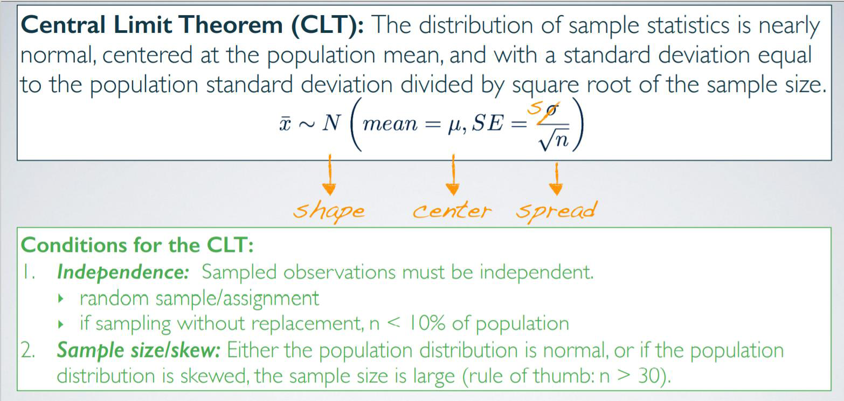

Slide 25
Central Limit Theorem- Example
Suppose you have a slightly right skewed population distribution of annual incomes in a developed nation, with mean 30000$ and SD 20000$. Suppose you take random samples of size 625 from this population of 10000. Which of the following is most likely to be the distribution of the means of these samples?
Right skewed, mean = 30000$, SD = 20000$
Nearly normal, mean = 30000$, SD = 20000$
Nearly normal, mean = 30000$, SD = 20000$ / (625)^{1/2}
Nearly normal, mean = 30000$, SD = 20000$ / (10000)^{1/2}
Left skewed, mean = 30000$, SD = 20000$ / (625)^{1/2}
Notes:
Ans. ‘c’

Slide 26
Conclusion
1. Described the Properties of Estimators
2. Explained Sampling Distribution
3. Described the Relationship between Populations & Sampling Distributions
4. Stated the Central Limit Theorem
5. Solved Probability Problems Involving Sampling Distributions

